Slide 1
SS ZG 526: Distributed Computing
Second Semester 2014-2015
Lect 9: Remaining Chapter 5, and DME
Chittaranjan Hota, PhD
Dept. of Computer Sc. & Information Systems
hota@hyderabad.bits-pilani.ac.in

Slide 2
Connected Dominating Set
A connected dominating set of a graph G is a set D of vertices with two properties:
  Any node in D can reach any other node in D by a path that stays entirely within D. That is, D induces a connected sub-graph of G.
  Every vertex in G either belongs to D or is adjacent to a vertex in D. That is, D is a dominating set of G.
SS ZG526, Distributed Computing

Slide 3
A Dominating Set (DS)
A Dominating Set (DS) is a subset of all the nodes such that each node is either in the DS or adjacent to some node in the DS.
A connected dominating set (CDS) is a subset of the nodes such that it forms a DS and all the nodes in the DS are connected.
SS ZG526, Distributed Computing

Slide 4
Applications of CDS
Virtual Backbone | Flooding
Reduction of communication overhead | Redundancy Collision
Reliability | Unreliability
CDS is used as a virtual backbone in wireless
networks.
SS ZG526, Distributed Computing

Slide 5
Applications of CDS: Broadcast
Only nodes in CDS relay messages
Reduce communication cost
Reduce redundant traffic
SS ZG526, Distributed Computing

Slide 6
Applications of CDS: Unicast
Only nodes in CDS maintain routing tables
Routing information localized
Save storage space
A → B ?
A: →
B:
C:
D: →
A → B ?
A:
B: ←
C: ←
D: →
C
D
B
A
A → B
SS ZG526, Distributed Computing

Slide 7
CDS construction
A simple heuristics: Create a spanning tree and delete the edges to the leaf nodes to get a CDS.
Another heuristics: Create an MIS and add edges to create CDS.
SS ZG526, Distributed Computing

Slide 8
An algorithm
Notations
Given a graph G and a DS C, all nodes in G can be divided into
three classes.
Black nodes: Nodes belong to C.
Grey nodes: Nodes are not in C but adjacent to C.
White nodes: Nodes are neither in C nor adjacent to C.
C
SS ZG526, Distributed Computing

Slide 9
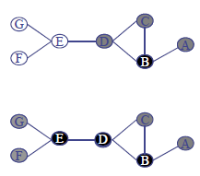
An algorithm continued…
Guha’s algorithm
Select the node with the max number of neighbors as a dominating node.
Iteratively scans the grey nodes and their white neighbors. Select the grey node or the pair of nodes with the max number of white neighbors.
SS ZG526, Distributed Computing

Slide 10
Leader Election: Motivation
We often need a coordinator in distributed systems
  Leader, distinguished node/process
If we have a leader, mutual exclusion is trivially solved
  The leader determines who enters Critical Section
  Inefficient though…
SS ZG526, Distributed Computing

Slide 11
Lelang-Chang Algorithm
Each node has a unique identifier
Nodes only send messages clockwise
Each node acts on its own
Protocol:
  A node sends election message with its own id clockwise
  Election message is forwarded if id in message larger than own message
  Otherwise message discarded
A node becomes leader if it sees it own election message
election msg for 7
election msg for 7
2
8
7
5
4
Complete graph
  Each node sends its id to all other nodes
  Wait until you receive n ids
  Biggest id wins
SS ZG526, Distributed Computing

Slide 12
Distributed Mutual Exclusion
What is mutual exclusion?
1. Can you allow two/more processors to update a file simultaneously?
2. Can two processes send their data to a printer?
So, it is exclusive access to a shared resource or to the critical region.
SS ZG526, Distributed Computing

Slide 13
Continued…
In uni-processor systems, mutual exclusion is achieved by semaphore, monitors, mutex etc.
An algorithm used for implementing mutual exclusion must satisfy
  Mutual exclusion
  No starvation, -Freedom from deadlock, -Fault tolerance
To handle mutual exclusion in distributed system,
- Centralized Approach
- Distributed Approach
- Token-Passing Approach
All use message passing approach rather than shared variable.
SS ZG526, Distributed Computing

Slide 14
Performance of DME Algorithms
Performance of each algorithm is measured in terms of
- no. of messages required for CS invocation
- synchronization delay (leaving & entering)
- response time (arrival, sending out, Entry & Exit)
System throughput = 1/(sd+E)
SS ZG526, Distributed Computing

Slide 15
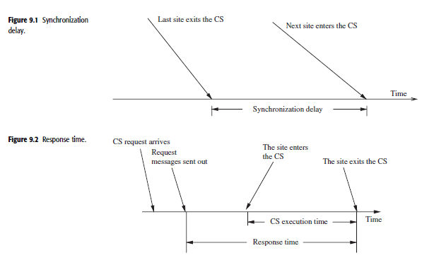
Continued…
SS ZG526, Distributed Computing

Slide 16
A Centralized DME Algorithm
A Central controller with a queue for deferring replies.
Request, Reply, and Release messages.
Reliability and Performance bottleneck.
SS ZG526, Distributed Computing

Slide 17
Lamport’s DME
Requesting the critical section.
1. When a site Si wants to enter the CS, it sends a REQUEST(T=tsi, i) message to all the sites in its request set Ri and places the request on request_queuei.
2. When a site Sj receives the REQUEST(tsi , i) message from site Si, it returns a timestamped REPLY message to Si and places site Si ’s request on request_queuej.
Executing the critical section.
Site Si enters the CS when the two following conditions hold:
1. Si has received a message with timestamp larger than (tsi , i) from all other sites.
2. Si ’s request is at the top of request_queuei.
SS ZG526, Distributed Computing

Slide 18
Continued…
Releasing the critical section.
1. Site Si, upon exiting the CS, removes its’ request from the top of its’ request queue and sends a time stamped RELEASE message to all the sites in its request set.
2. When a site Sj receives a RELEASE message from site Si , it removes Si ’s request from its request queue.
3. When a site removes a request from its request queue, its own request may become the top of the queue, enabling it to enter the CS. The algorithm executes CS requests in the increasing order of timestamps.
SS ZG526, Distributed Computing

Slide 19
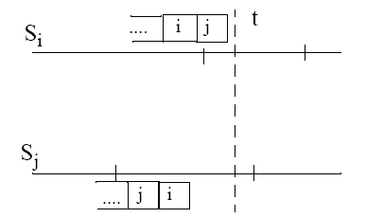
Correctness
Suppose that both Si and Sj were in CS at the same time (t).
Then we have:
SS ZG526, Distributed Computing

